Slide 1
Flight Status Tracker
Developed Using React JS
FEDF
Sec ~ 12
Batch No. ~ 13
Team Lead ~ K. Saanvi
2520030083
Team Member ~
S. Ketana Sindhu
2520030487

Slide 2
Introduction
The Flight Status Tracker is a web-based application developed using React.js to help users access flight-related information through a simple and user-friendly interface. The project provides separate Home, Login, and Sign-Up pages with smooth navigation between them using React Router. The Home Page serves as the main landing page, while the Login and Sign-Up pages allow users to authenticate and create accounts. This project demonstrates the use of modern front-end development technologies such as React, JSX, CSS, Vite, and GitHub for creating responsive and interactive web applications. The application is designed with a clean interface and can be further extended with real-time flight tracking features in future versions.

Slide 3
Problem Statement
Passengers often face difficulty in checking flight information quickly. This project helps users easily access flight status and details through a responsive web application.

Slide 4
Objectives
To build a React-based web application
To provide flight search functionality
To create a user-friendly interface
To implement multiple pages using routing

Slide 5
Technologies Used
React JS
Vite
CSS
React Router DOM
GitHub

Slide 6
Modules Implemented
Home Page
Login Page
Contact Page
Flight Search Page
Flight Details Page
Signup Page

Slide 7
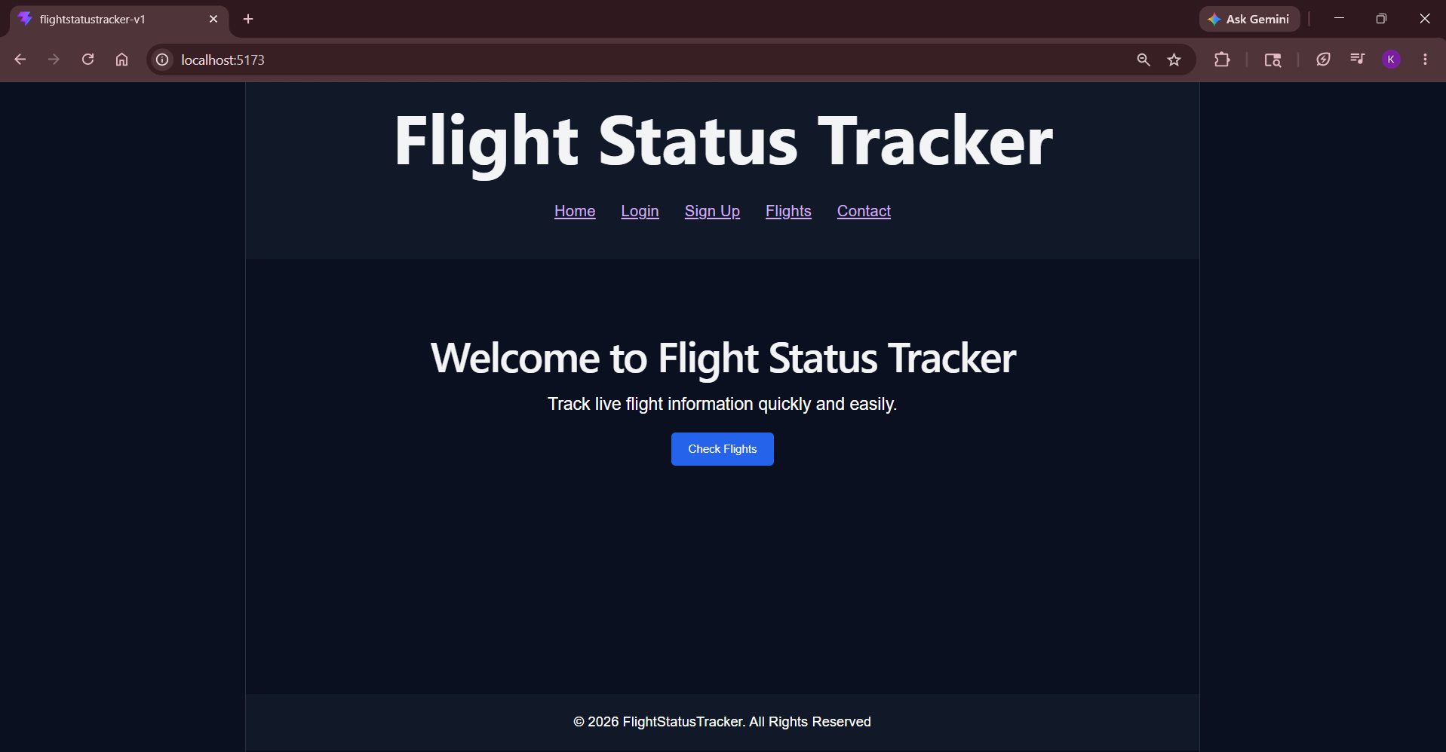
Home Page Screenshot
Home Page

Slide 8
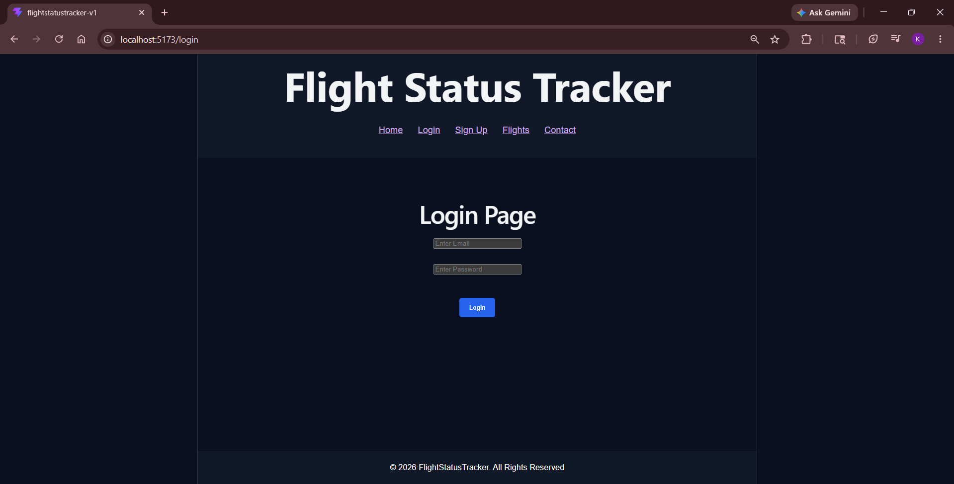
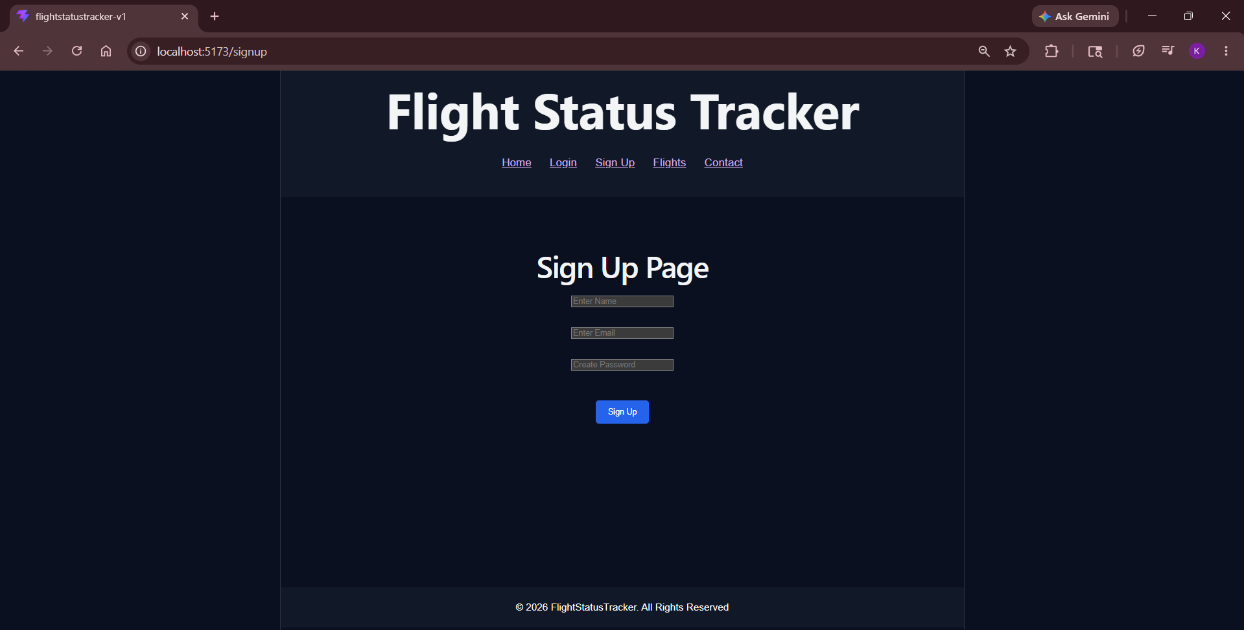
Login & Signup
Login Page
Signup Page

Slide 9
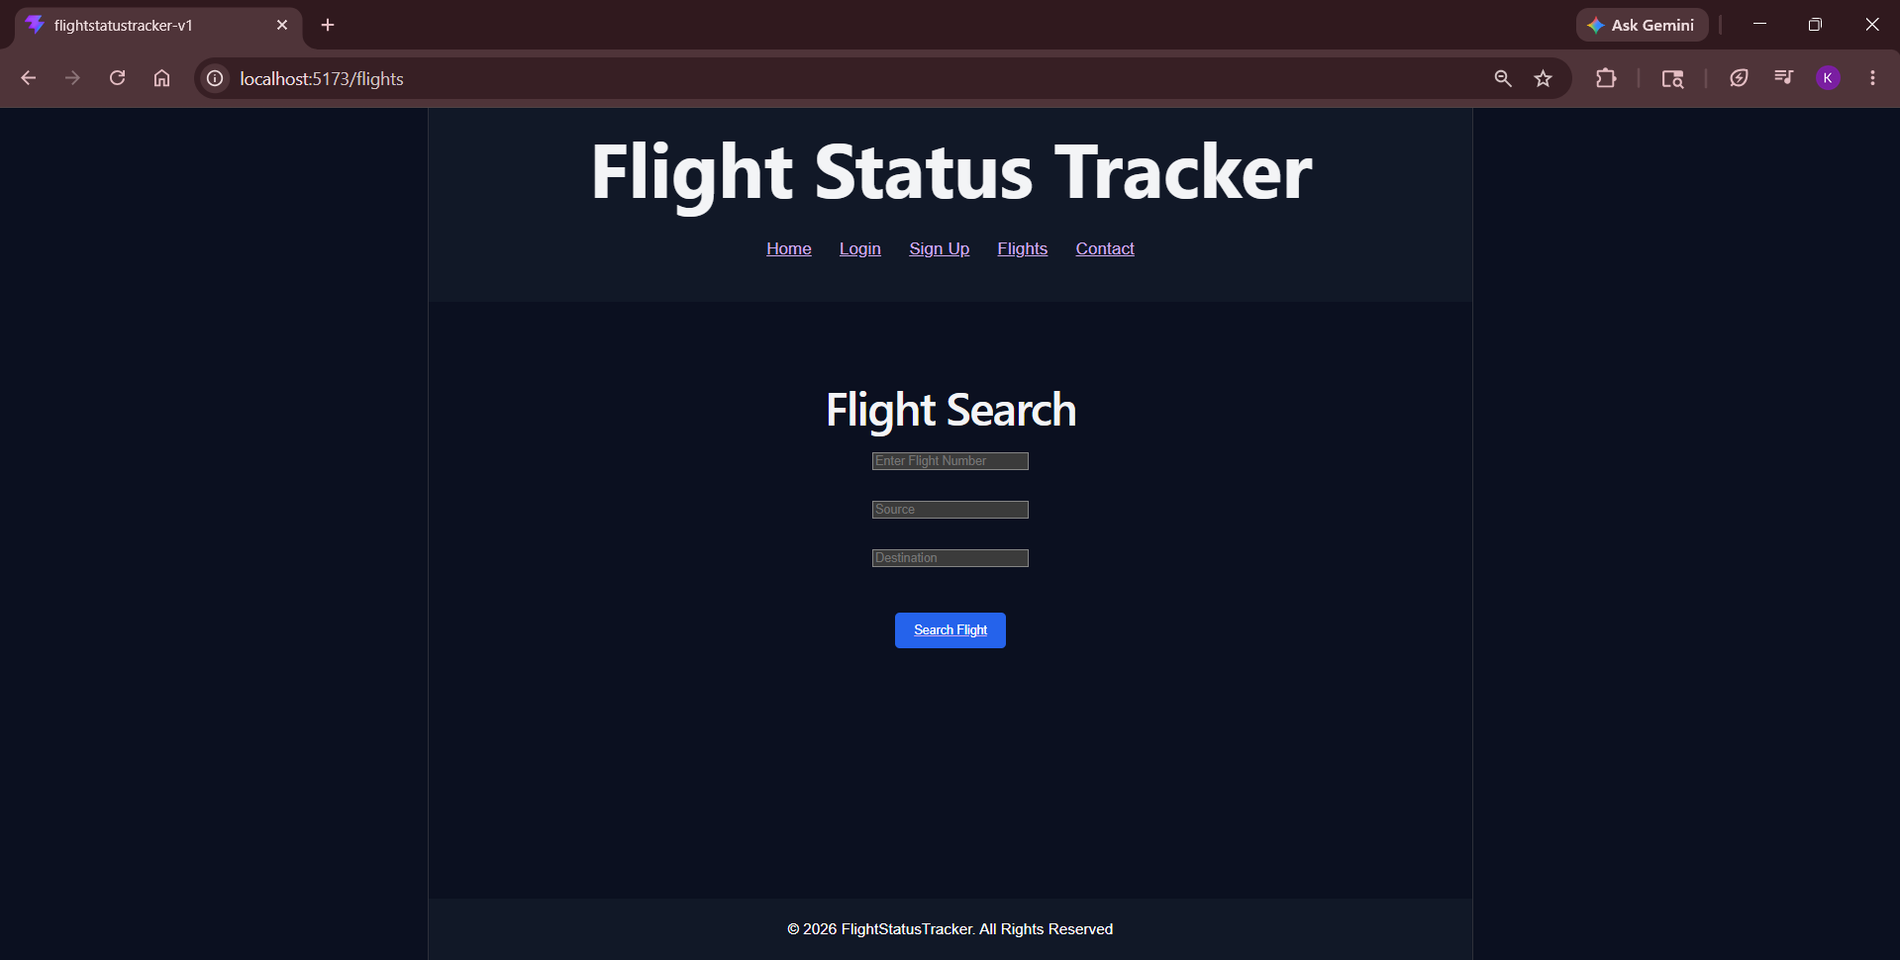
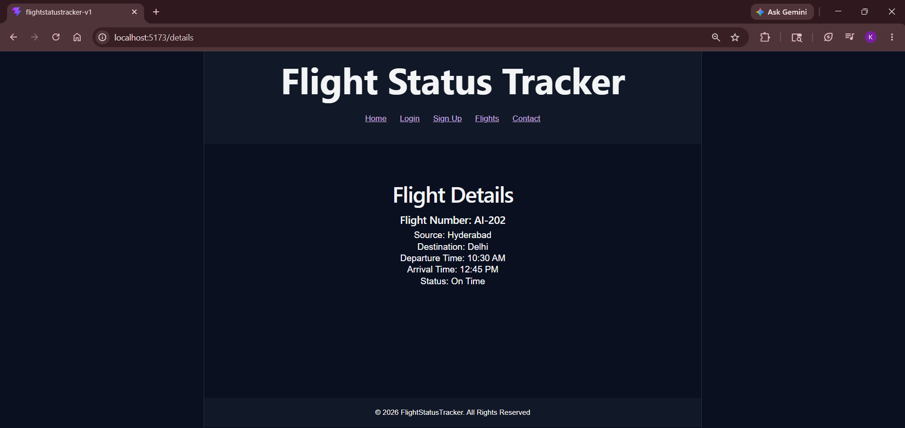
Flight Search & Details
Flight Search Page
Details Page

Slide 10
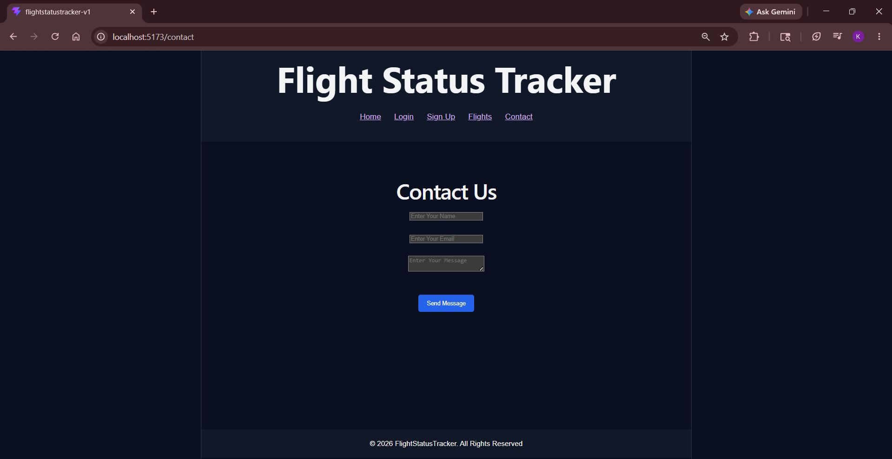
Contact Page
Contact Page

Slide 11
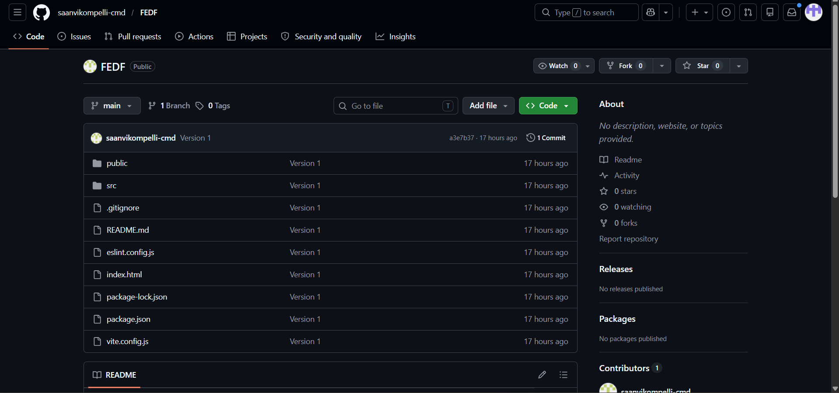
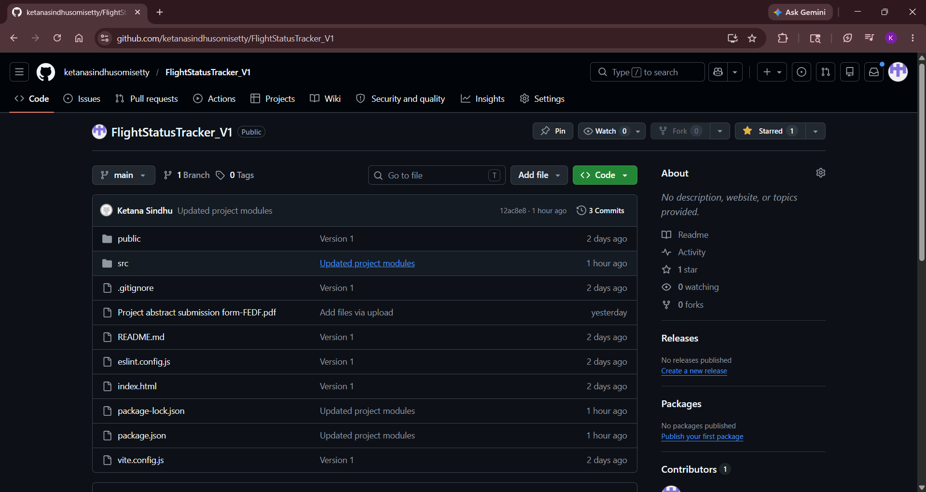
GitHub Repository
Links:
Saanvi
https://github.com/saanvikompelli-cmd/FEDF
https://github.com/ketanasindhusomisetty
Sindhu

Slide 12
Future Enhancements
Live Flight API integration
Database connectivity
Real-time flight tracking
User authentication
Responsive mobile support
Admin Dashboard

Slide 13
Conclusion
The Flight Status Tracker project successfully demonstrates the implementation of a modern web application using React.js. The application includes a Home Page, Login Page, and Sign-Up Page with proper navigation and responsive design. Through this project, concepts such as component-based architecture, routing, user interface design, and version control using GitHub were applied effectively. The project fulfills the current development requirements and provides a strong foundation for future enhancements, including real-time flight status updates, user management, and advanced flight search functionalities

Slide 14
Thank You

